Slide 1

PRACTICAL MACHINE LEARNING
AI-Driven Retention Strategy
Classification Model for Predicting Job Change Potential
Prof.Mihai Toma , Prof.Piotr Wójcik | Assessment Submission

Slide 2

Project Overview & Dataset
Developing a robust classification system to identify employees willing to change jobs based on the job_change dataset.
Key Features Analyzed
Gender, Age, Education Level, County Code, Relative Wage, Years of Experience, Company Size, and Certification Status.
•
Training Sample: 12,427 observations
•
Test Sample: 3,308 observations
•
Objective: Optimize for Balanced Accuracy (Macro Avg)

Slide 3
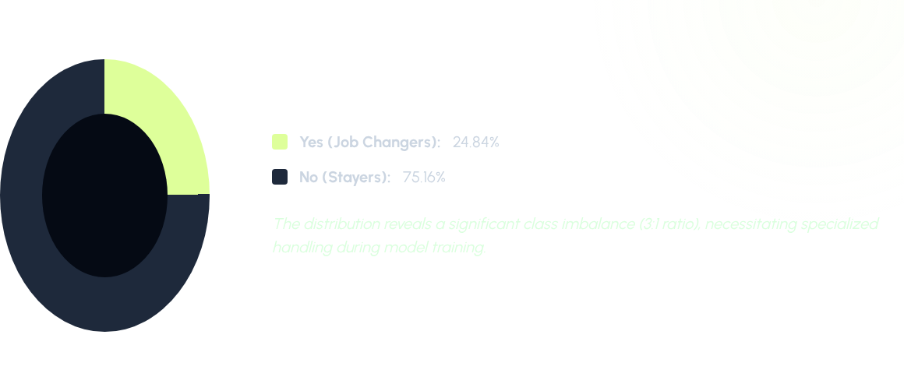
Target Variable Distribution

Slide 4





Experimental Design
5-Fold CV
Tuning
Balancing
Implemented Stratified Cross-Validation to ensure performance stability across the imbalanced dataset classes.
Exhaustive Hyperparameter optimization for Random Forest and XGBoost (Max Depth, Estimatotrs, Learning Rate).
Applied weight-scaling (scale_pos_weight=3) in the final model to penalize misclassified minority samples.

Slide 5
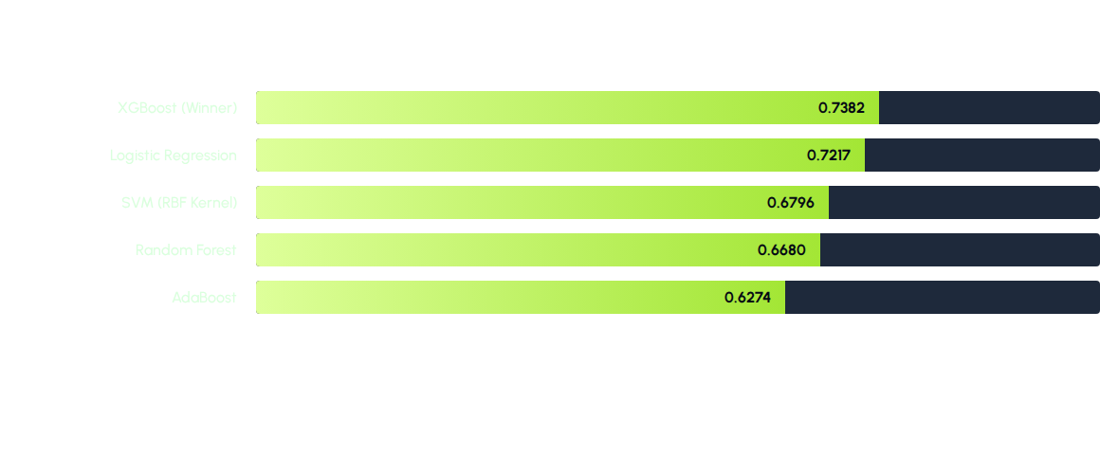
Benchmark Results: Model Comparison
Performance Metric: Mean Balanced Accuracy across 5-Folds

Slide 6

Selected Model:
XGBoost
Primary Selection Factors:
•
Highest Balanced Accuracy during CV (0.7382).
•
Superior handling of non-linear interactions between variables like wage and company type.
•
Built-in support for imbalanced datasets via weight parameters.
Final Params: scale_pos_weight=3, n_estimators=250, learning_rate=0.05

Slide 7

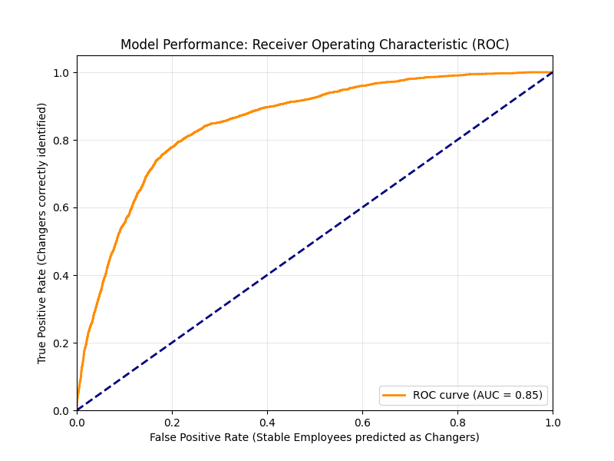
Overall Performance Summary
0.8524
Model AUC Score
Key Takeaways
The Area Under the Curve (AUC) of 0.85 indicates excellent discriminative power, allowing for reliable threshold adjustments for specific HR priorities.
Expected Accuracy: ~74% Macro Avg

Slide 8
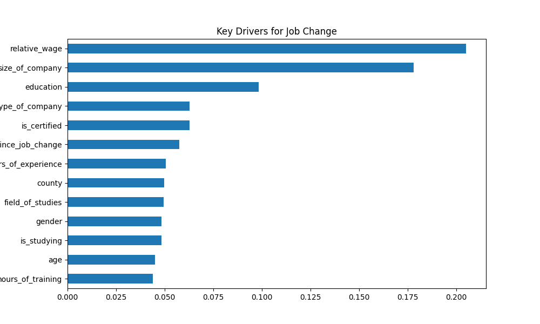
Predictive Drivers (Feature Importance)
Wages relative to county averages remain the #1 predictor of attrition risk.

Slide 9
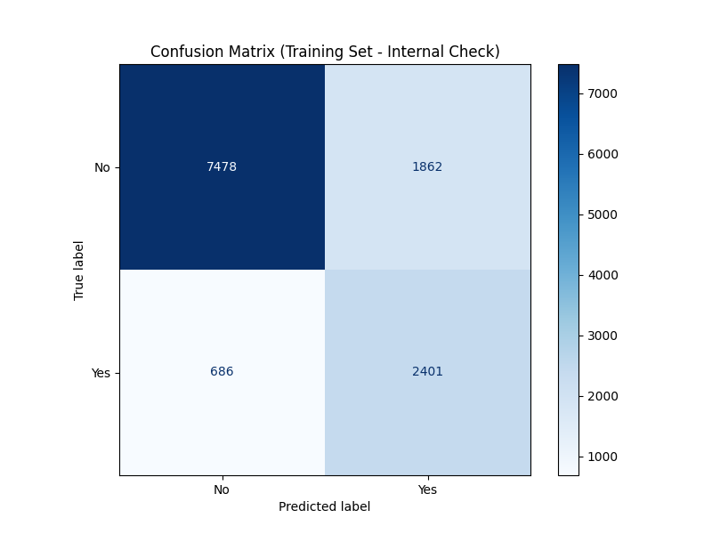
Confusion Matrix: Prediction Analysis
Internal check on Training set validation. Final model prioritizes capturing as many 'Yes' cases as possible through specific weighting.

Slide 10
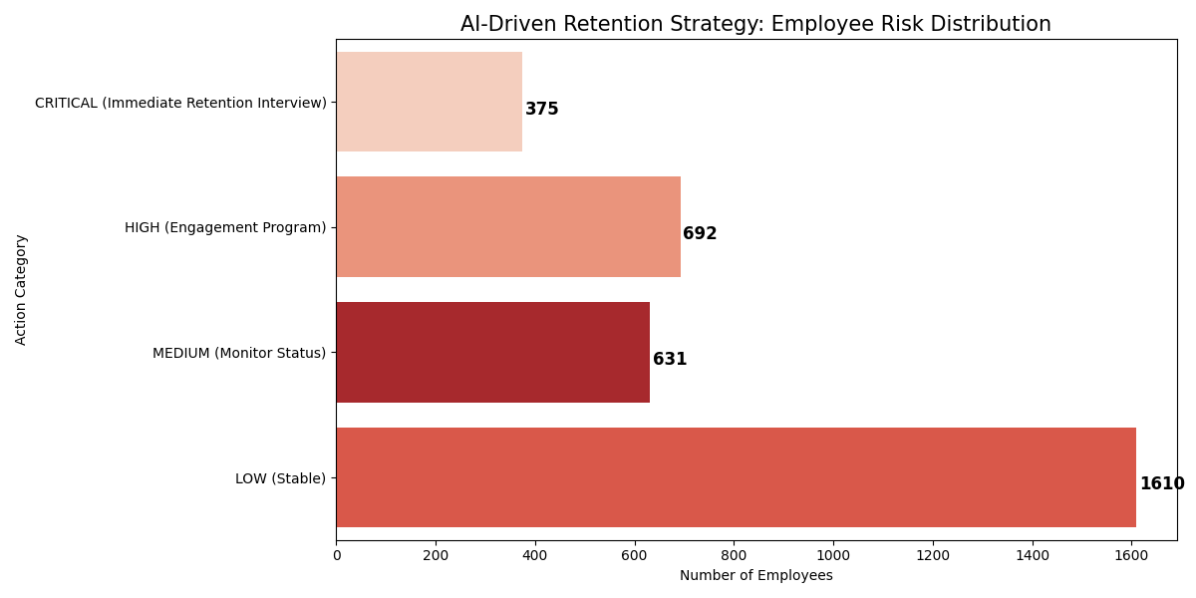
HR Strategic Action Summary

Slide 11
Deployment & Next Steps
Model Serialized
Feature Pipeline
Live Scoring
Final Report
Saved as retention_model_xgb.pkl
Saved as model_columns.pkl
Real-time prediction API ready
Performance validated & submitted

Slide 12
Thank you for your time.
XGBOOST DEPLOYED | 0.8524 AUC | CLASS BALANCED

